Slide 1


SAP UI5 & FIORI
Installing SAP UI5
www.zarantech.com
© Copyright 2021, ZaranTech LLC. All rights reserved.

Slide 2

Disclaimer
2
This presentation, including examples, images, and references are provided for informational purposes only.
Complying with all applicable copyrights laws is the responsibility of the user.
Without limiting the rights under copyright, no part of this document may be reproduced, stored or introduced into a retrieval system, or transmitted in any form or by any means.
Credits shall be given to the images taken from the open-source and cannot be used for promotional activities.
© Copyright 2021, ZaranTech LLC. All rights reserved.

Slide 3
Agenda
3
Installing SAP UI5
Naming Conventions for Control and Application
Browser and Platform Matrixes
Compatibility Rules
Experimental Flag
© Copyright 2021, ZaranTech LLC. All rights reserved.

Slide 4

Installing SAP UI5
2
Lets see, How to Install SAP UI5?
‹#›
© Copyright 2021, ZaranTech LLC. All rights reserved.

Slide 5
Installing SAP UI5
2
Naming Conventions for Control and Application - Variables
Variable names: First letter small and followed by camel-case on all the words.
listItem (first letter small and second word first letter capital)
Listitem (wrong. first letter to be small)
detailPageController (right)
detail_page_controller (wrong)
While naming parameters, make sure that the names are expressive and relevant.
Eg. invSplitApp is correct, invoiceOrderSplitAppController is wrong.
‹#›
© Copyright 2021, ZaranTech LLC. All rights reserved.

Slide 6
Installing SAP UI5
2
Naming Conventions for Control and Application – Class names
While it is imperative that the classes be named according to the functionality, it is best to keep the names short.
The naming should be first letter capital followed by camel casing for the remaining words.
invMaster
InvMaster
inv_master
‹#›
© Copyright 2021, ZaranTech LLC. All rights reserved.

Slide 7
Installing SAP UI5
2
Naming Conventions for Control and Application – Line Spaces
Every variable or local declaration needs to be put in single line as much as possible unless there is some custom filters or mapping or formatting is involved.
Put single indentation for all the variables declared.
‹#›
© Copyright 2021, ZaranTech LLC. All rights reserved.

Slide 8
Installing SAP UI5
2
Naming Conventions for Control and Application – Function Names
All the function names should have a verb as first word stating the general function it does (exception for Formatters and validators).
Eg. createContent, getUserDetails.
All the functions need to be camel cased (same as variable names).
Every function should have a brief description comment above it to state what it does.
The description should be brief and should always contain the input variable names and their type.
‹#›
© Copyright 2021, ZaranTech LLC. All rights reserved.

Slide 9
Installing SAP UI5
2
Naming Conventions for Control and Application – Elements in Views
For all the JS views, it is recommended to have the elements accessed as member variables.
Usage of global variables for referring to pages or elements is highly discouraged.
For all the events on an element, give two inputs: the function to be called and the context element that is to be given for the function.
The context element will be referred as this inside the function.
‹#›
© Copyright 2021, ZaranTech LLC. All rights reserved.

Slide 10

Installing SAP UI5
2
‹#›
© Copyright 2021, ZaranTech LLC. All rights reserved.

Slide 11
Installing SAP UI5
2
General DO’s & Don'ts
Never have any variables outside the class (global variables) unless it is cannot be done away with.
Maintain all the configuration values (like meta data url, etc.) as a config parameter in a separate Service class
When trying to customize the UI, always use class based styling by adding a new class.
Avoid writing ids for views created in JS views and reusable components (like side menu).
Always have a unique name for id if it's necessary.
Custom controllers are encouraged for any kind of new functionality that may be out of the scope of UI5.
Do not use console.log. Use jQuery.sap.log.info() or other levels for debugging purpose.
11
© Copyright 2021, ZaranTech LLC. All rights reserved.

Slide 12
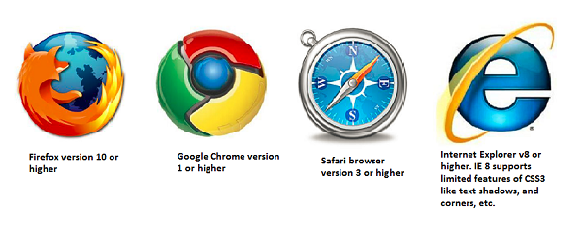
Installing SAP UI5
2
Browser & Platform Matrices
SAP UI5 supports all the main browsers from Microsoft, Google and Firefox with latest releases. However, features supported varies with the browser version and the vendor.
12
© Copyright 2021, ZaranTech LLC. All rights reserved.

Slide 13
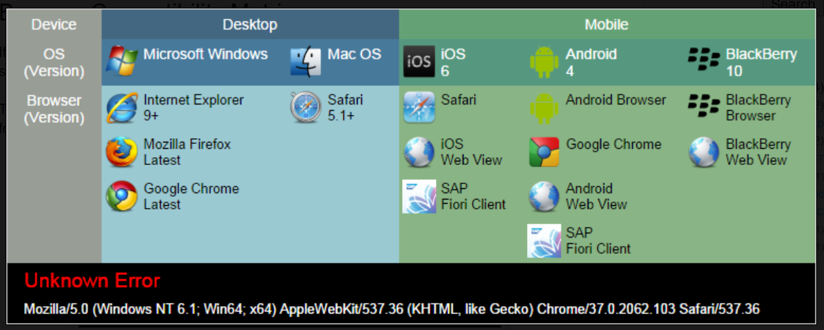
Installing SAP UI5
2
12
© Copyright 2021, ZaranTech LLC. All rights reserved.

Slide 14

Overview of SAP UI5 & Fiori
2
Compatibility Rules
SAPUI5 is a so-called Release Independent Component (RIC).
An important constraint for this is that it must be as simple as possible to upgrade to a newer version.
This makes compatibility rules so important.
‹#›
© Copyright 2021, ZaranTech LLC. All rights reserved.

Slide 15
Overview of SAP UI5 & Fiori
2
Compatibility Rules – Versioning Scheme
SAPUI5 uses a 3 digit version identifier, for example 1.4.3. The digits have the following meaning:
The first digit (1) specifies the major version number.
The second digit (4) specifies the minor version number.
The third digit (3) specifies the patch version number.
‹#›
© Copyright 2021, ZaranTech LLC. All rights reserved.

Slide 16
Overview of SAP UI5 & Fiori
2
Compatibility Rules – API Evolution
"API" refers to "public API", meaning functions, classes, namespaces, controls with their declared properties, aggregrations, and so on.
A major release, with a new major version can introduce new APIs or make incompatible changes to existing APIs.
A minor release, with a new minor version can introduce new APIs, but does not contain incompatible changes to APIs, introduced in the same major release.
A patch release, with a new patch version, only contain fixes to the existing implementation, but do not introduce new features or incompatible API changes.
‹#›
© Copyright 2021, ZaranTech LLC. All rights reserved.

Slide 17
Overview of SAP UI5 & Fiori
2
Experimental Flags
Some features or controls delivered with this SAPUI5 version are flagged as “experimental”.
These experimental features and controls are not part of the released scope of the delivered SAPUI5 version.
Experimental features or controls can be changed, or deleted, at any time without notice and without a formal deprecation process.
The purpose of including experimental features and controls in a public release is to collect feedback from partners and customers at an early stage.
‹#›
© Copyright 2021, ZaranTech LLC. All rights reserved.

Slide 18
Thank you
Subscribe to our Channel for more Informative Videos.
https://www.youtube.com/user/ZaranTech

